Slide 1
Redefine Failure How Yammer is creating a learning organization
Nate Fink
Head of Engineering
Yammer / Microsoft
Notes:
I'm Nate Fink. I'm the Head of Engineering for Yammer. Yammer is the leading enterprise social network, company was acquired by Microsoft in 2012. We’re now over 150 engineers in three locations, and we’re continuing to push forward in an uncertain new space, which has led us to believe that our primary imperative as a team is to be able to learn and adjust as rapidly as possible, which has given us a new perspective on failure.
I'm going to talk about what how we're creating a learning organization that can adapt quickly to new information and some of the tradeoffs we're making to remain agile as we've scaled up the team. In particular, I’ll share my personal story of having gone from long-cycle enterprise software releases to continuous delivery and experimentation, and what it’s taught me.
I'm also hoping you'll challenge me on some of these things and share what's working for you.

Slide 2
My personal journey
Notes:
Enterprise software, on-prem releases
Multi-yr cycles, yrs of customers deploying. We had a great process for this world. Months of planning upfront, betas, long testing periods. Slow feedback, too late to affect planning the next release. And we really only got one shot every few years, so we…
HAD TO BE RIGHT (at least most of the time). Cost of being wrong was super high.
Then I got the opportunity to be part of acquiring Yammer. It felt like a huge weight had been lifted when I saw what we were able to do when we were the ones running the servers and got to deploy new builds ourselves. We could try things and learn incredibly quickly. It was very freeing and felt like I’d come home.
One of the first things we did was to take a team of about 60 people at Microsoft headquarters who’d been used to those multi-year releases, and started working the Yammer way. We encountered a bunch of technical and non-technical challenges that in large part inform this talk.

Slide 3
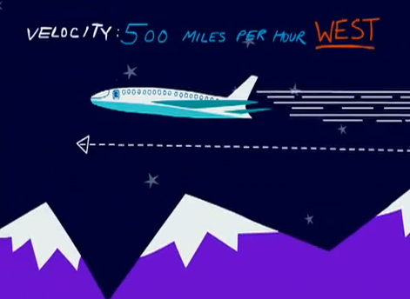
We don’t know where we’re going,
but we’re making good time
Notes:
The definition is important. Velocity is not just speed, it’s speed in a given direction. And we want to sustain our velocity over time. We want to be going the right direction, as fast as possible.

Slide 4
But what if we aren’t sure where the airport is?
WHAT IF THE AIRPORT IS MOVING?
Notes:
We have a harder job than that airplane in that we don’t have high certainty of where the airport is, and worse, the airport is probably moving over time.
To maintain high velocity, not only do we have to keep up our speed, we have to to able to check our position, and have high agility as we go so we keep going the right direction.

Slide 5
Efficiency vs. Responsiveness
Notes:
One analogy we like is gold mining. We’d found a couple big veins of gold, and we built ever more elaborate (and efficient) machines to mine that gold. We were the best in the world at mining that one big mine. However the gold was starting to dry up, lots of competitors were coming in with not much more than a pan and a shovel, and they were chipping away at us. More, they could just move to wherever the gold was easily, and we were stuck with a huge complicated machine that didn’t know how to do anything else.
What we started realizing was that in our pursuit of the worthy goal of efficiency, we’d become incredibly unresponsive to new information. We were perfectly equipped for a world that no longer existed. Things were changing quickly, and we couldn’t.

Slide 6
Notes:
The problem they're trying to solve is that they're having a hard time keeping up with their customers. Companies are struggling to keep up with the pace of change. Companies are struggling to keep up because the world formed a giant network while companies have remained hierarchies that are unable to find, share, learn, adapt as quickly and easily as the people they served. Employees had a rich network to draw from at home where they could find information or people who could help them. This same network that was rapidly changing their expectations of the companies that serve them. But at work, they had no such network to draw from. We learned that the real value of enterprise social was the network.

Slide 7
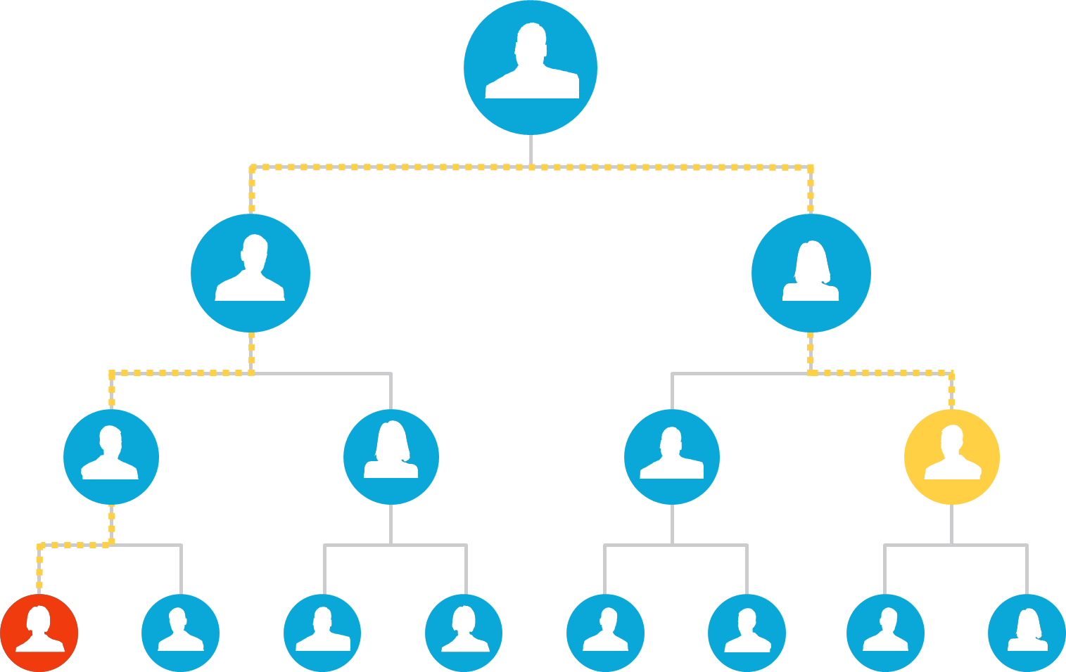
Notes:
The problem they're trying to solve is that they're having a hard time keeping up with their customers. Companies are struggling to keep up with the pace of change. Companies are struggling to keep up because the world formed a giant network while companies have remained hierarchies that are unable to find, share, learn, adapt as quickly and easily as the people they served. Employees had a rich network to draw from at home where they could find information or people who could help them. This same network that was rapidly changing their expectations of the companies that serve them. But at work, they had no such network to draw from. We learned that the real value of enterprise social was the network. So at the end of the day, we realized we were building software that helped companies Work Like a Network so they could keep up with their employees and customers.
In many ways we ran companies much like you’d build a rube goldberg machine. We carefully constructed the machine to execute exactly as planned towards a predictable outcome. How many minutes should a customer service person remain on each call? How much sales should the northeastern regional sell for product X next near? How many engineers will be needed on project Y? It was our belief in predictability that drove us both to focus on efficiency. Yet, the more efficient we became, the more rigid.
What did companies do as their plans began to unravel before they were complete? Focus even MORE on efficiency! Companies have been in a vicious spiral of attempting to use efficiency to fix the very problem focusing on efficiency caused.
But in today’s world of ubiquitous information there is almost no latency between when you take an action and can receive feedback on it’s impact. And yet, if all you’re doing is executing on long turn plans without taking in that new information you’re essentially wasting that information. And if we have a competitor that is more able to act on that information, they now have a competitive advantage over us.
Furthermore, the value of information decreases over time. So even if we ARE collecting all of this information, by the time we act on it, it may already be too late.
The old world was about optimizing for efficiency and information arbitrage.
Yet this model only works if you can predict the future.
[HOW MANY OF US CAN PREDICT THE FUTURE?]
Because we can't predict the future, our competitive advantage now depends on how quickly our organization can learn and respond to new insights about our customers. We must focus on optimizing for responsiveness and throughput.

Slide 8
Shorter cycles enable learning
Avoiding mistakes vs
Embracing them and learning from them
Notes:
We believe software development in today’s world is necessarily the pursuit of dynamic goals rather than static goals.
We’re frequently asked about the tradeoffs around planning and predictability. In order to understand why these tradeoffs are made, it’s first important to understand that software development in a world of continuous deployment is necessarily the pursuit of dynamic goals rather than static goals. Because software services can be constantly adjusted and measured, we have access to a steady stream of new information that we’d be foolish to ignore. This information will inevitably lead us to a better picture of what we should be shipping over time.

Slide 9
Failure is not trying things that don’t work.
Failure is failing to learn.
Notes:
If we're only doing things guaranteed to succeed, we're not being very bold, and worse we’re not learning.
If we can learn and adjust quickly, we should strive for doing lots of things that work and lots of things that don’t.
Failure isn't doing something that doesn't work, failure is failure to learn from what we're doing so we can improve.
This is easy to say, hard to do.

Slide 10
Feedback Loops Hierarchy of Needs
Technical
Deliver Frequently
Measure Impact
Organize for Adaptation
Experiment More, Plan Less
Cultural
Notes:
Let’s shift gears and talk about HOW to actually create and use a fast feedback loop in our organizations.
In going through the transition from years-long release cycles to how Yammer works, and in helping a few Microsoft teams make similar transitions, I’ve stumbled upon a sort of hierarchy of needs. What I’ve seen is a lot of teams start at the end only to get hung up on the basic levels, so I’ll start basic and build up.
Okay, so the first two steps are about creating a fast feedback loop. Deliver frequently, and measure. This is largely but not completely a technical challenge. The second two steps in orange here are about using that fast feeback loop to learn and adjust.

Slide 11
Problem 1: We were shipping too slowly
Deliver Frequently
Measure Impact
Organize for Adaptation
Experiment More, Plan Less
Notes:
We were shipping too infrequently to be agile. Just going through the motions on agile. Until we got this down to a week or so, it was very difficult to do anything but shrink our old big process.
Solution: duh, ship more frequently. Largely technical, but changes everything about your process as those of you who are already doing this know. QA, tools, deployment, …
NOT Just software! Tell Red Robin burger story.
Microsoft teams shipping every six months. Can only learn every six months.
At yammer, we create project teams of 2-10 people for 2-10 weeks, and we encourage them to ship as often as they can to learn and iterate. We can deliver within hours for most changes, a week for the slowest. We push this faster all the time.

Slide 12
Notes:
Red Robin burger cycle time.

Slide 13
Problem 2: We couldn’t measure the impact of changes
Measure Impact
Deliver Frequently
Organize for Adaptation
Experiment More, Plan Less
Notes:
Technical part: building your data pipeline, doing the right data analysis, providing that to the right people quickly.
Hard part: Have to figure out what you care about! Need leading indicators that you can move.
At Yammer, we created a data pipeline to track what our users were doing with our software. Our data analytics team helped us move from looking at just sales, which took months to see results, to 7-day user engagement metrics that told us how people were using our service. They showed that if we drove usage higher, sales would follow. We could see that we could move those user engagement metrics pretty easily by making product changes, so at that point we had ourselves a nice fast feedback loop. We could ship within a day, and within a week we could see whether the change was positive, negative, or neutral. It was surprisingly often that our best ideas turned out to be losers. We figure at this point that we have about the same batting average as a decent baseball hitter. Maybe a third.

Slide 14
Be careful with metrics
Notes:
Local maximum – don’t just optimize, need to explore to learn.
Another problem I keep seeing in bigger teams is global metrics vs. local metrics.

Slide 15
Beware local optimization
Notes:
Another problem I keep seeing in bigger teams is global metrics vs. local metrics.
Sign-up flow example.

Slide 16
Problem 3: We were committing to long range plans
Measure Impact
Organize for Adaptation
Deliver Frequently
Experiment More, Plan Less
Notes:
Okay so now that we can deliver quickly and we can measure your impact, we have a feedback loop. Now our problems are about how to use these feedback loops - largely cultural and organizational.
This biggest problem we encountered was that our culture didn’t embrace failure. We SAID we did, but we didn’t mean it.
Everyone was judged on making a plan and delivering on it. Which meant that failure wasn’t an option. So literally every single idea that made it through prioritization would ship, whether it was good or not. No one wanted to be wrong. No one wanted to be the person whose feature turned out to be a bad idea. This meant a LOT of time was spent upfront making plans, arguing about how the thing should work, whether it was a good idea, or not. At Yammer, we did very little of this. Instead of arguing, we made it cheap to test ideas in the wild, and we were embracing the notion that we’d only be right some of the time.
Three, new language, Safe to Try.
Safe To Try
Transparency, shared learning
Make it safe to be wrong
Delight in it
Only failure is failure to learn something actionable
HACK DAY
Story about WAC team learning the little thing crushed the big thing in the data. Changed everything about how they prioritized.

Slide 17
Notes:
About a third of our ideas win, a third lose, a third we argue about. I was just looking at our analytics data, and it looks like in the last few months about half of our tests have ended up with a “ship it” conclusion.
We’re about as good as a major league baseball player.
So one key for us is to take as many swings as we can. It’s fine to miss two thirds of the time

Slide 18
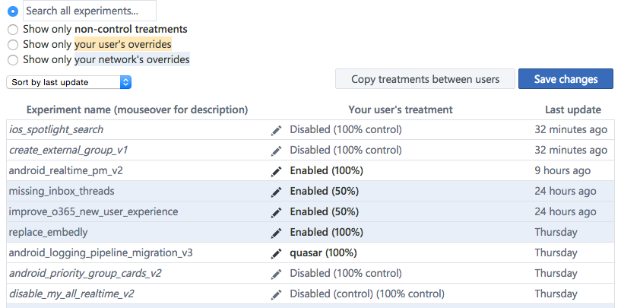
~50% of Yammer’s A/B tests
result in a “Ship It” outcome
Notes:
About a third of our ideas win, a third lose, a third we argue about. I was just looking at our analytics data, and it looks like in the last few months about half of our tests have ended up with a “ship it” conclusion.
We’re about as good as a major league baseball player.
So one key for us is to take as many swings as we can. It’s fine to miss two thirds of the time

Slide 19
Sad customers and bosses are a problem
Notes:
And yet customers and executives wanted to know what we were planning on, and we’d tell them. They’d expected us to do what we said we’d do.
They also often thought of success as shipping the most things, because previously we couldn’t really correlate specific features with value.

Slide 20
Sad product managers are a bigger problem
Notes:
Our product managers felt this the most. They felt like they had to make the slide deck laying out the feature roadmap and ship what was on it.
They felt judged on what they shipped, not what value they’d delivering in the form of either proven product impact or learning.
FAIL DAY

Slide 21
Conviction and Humility
Notes:
Still working at this. Finding the Balance of long-term clarity and conviction, with the knowledge that many of the things we’ll try won’t work, and we don’t want to be saddled with them. We were so worried about overdoing it on conviction that we overdid it on humility and no one understood what direction we wanted to go.
Have a clear direction, be humble enough to measure and adjust. Measure impact, not number of features.

Slide 22
Problem 4: Our org chart locked in our assumptions
Measure Impact
Experiment More, Plan Less
Deliver Frequently
Organize for Adaptation
Notes:
Okay so now you have a fast feedback loop, and your team is no longer afraid of failure. You’re trying things quickly, you’re learning. However, what we realized then is that the org chart was holding us back.
It was slowing us down in terms of how fast our cycle time could be, how fast we could try something.
And then it was also slowing us down in terms of how easily we could shift what we were working on.
At one point in Yammer’s history, we had a search team. They owned the search functionality. It was great for expertise and accountability, but it meant that we had a team that would always be working on Yammer search, whether that was our top priority or not. Our plans were in effect baked into our org chart, and we simply couldn’t reorg every time we learned something new if we were learning constantly.
At Yammer today, we organize our work outside the org chart in temporary project teams brought together to solve a problem (or create learning) and then disband.

Slide 23
You can’t steer a ship that’s not moving

Slide 24
Cycle Time vs Efficiency

Slide 25
= Tech Lead
Notes:
So I’ve been in a couple different kinds of engineering teams. Some have organized around feature or product areas (e.g. you might have a search team or a files team), and some have organized around technology layers (e.g. you might have a database layer team and a UX layer team and have them take dependencies on each other for features).
This is the organizational structure of Yammer’s engineering team. We don’t organize in the usual ways around feature areas or code bases but around skills. The colors represent our engineering functional teams. Each functional team is an area of expertise we need to engineer a great product – right now we have a team for front end (web), web applications, mobile apps, and core services, sort of our backend team.
But none of the work happens in this structure!
Staffing Projects and Prioritizing Resources
Why not organize around features, codebases, skills
Org Chart for functional teams
Organized around skills. They do not own codebases.
Alignment: local vs. global
Perverse incentives to solve problems in your area regardless of whether it’s the best way to do it.
implicit priorities making it hard to reprioritize
Identity: Emotional attachment
Move around the code: Everyone’s eyes are on everyone’s work.
This is a good example of building an org that accomplishes your goals automatically: The alternative here is scheduling code reviews.
It gives everyone exposure to everyone else: Builds a sense of team. “This is the most cohesive team I’ve ever worked in.” -- UK engineer recently
Yammer’s org is made of pools of domain experts, not owners of codebases: The Front End Team. The Rails team. The Mobile Team. We've got others and you'd likely end up with different groups based on what your group does. Each of these teams has a manager, and that manager is tasked with making those engineers as effective as possible: Guiding the growth of their skills, removing organizational obstacles that the team points out, and working with the other managers to adjust the structure and functioning of the entire organization.
First we remove the managers.
Then we take EVERYONE required to complete a project (all disciplines) and put them on a project together.
Engineers can only work on one project at a time. They don’t even do support.
This is so that everyone on the team can rely on them without worrying how they’re using their time.
Decentralization
autonomous. lower communication cost.
Can focus on goals instead of just shipping
Collaborative: Engineers and PMs can negotiate the MVP: “We can build this, but it will take 6 weeks. Is it really that important?” or “It would be easy to add X, and I think it would help drive engagement.”
Work transparently (open groups)
Free to adjust the scope.
Release as much as they want.
Touch any codebases.

Slide 26
Project Completion
As projects finish (2-10 weeks)
= Team Lead
Notes:
Rotation! Tradeoff between efficiency of local teams and effectiveness of the whole. Constantly iterating on our approach here.
Emergent consistency
Lots of eyeballs across lots of the code
Fungibility, the team develops practices and architecture that make it easy to move around and for new devs to ramp up
Project completion
When a project finishes, new projects can be staffed with the engineers coming off.
Tradeoff: Our system makes this a little sloppy. Sometimes engineers are left with a small buffer between projects. This seems inefficient, but it’s outweighed by the big efficiency gains of the overall system.
Celebrate success: The teams go out to a nice lunch or for drinks.
Retrospective: Look back at what worked and didn’t in the project. Everyone provides input here. One of every project’s deliverables is better projects in the future.

Slide 27
This changes everything …and we’re still figuring it out
Notes:
Role of managers
Ownership
Accountability
On-boarding
Coding standards

Slide 28
Feedback Loops
Deliver Frequently
Measure Impact
Organize for Adaptation
Experiment More, Plan Less
Notes:
We had to create experiences for our teams that would enable us to get to these conclusions. It wasn’t enough to say it or ask for it.
Are there more steps? These are what we’ve discovered so far. If you have more, please tell us.

Slide 29
Reduce Friction For Change
“Is it safe to try?”
Notes:
One final language trick to help people be comfortable making changes frequently.
Flip the default from No to Yes. Trick from Holacracy organizations to limit endless debate. Easy to find reasons not to do things.
Say yes to a proposal unless someone can prove that it’s not safe to try, and that we couldn’t detect it going wrong quickly enough to recover.

Slide 30
“The only sustainable source of competitive advantage in any industry is the ability to learn faster than your competitors.”
Ari DeGues

Slide 31
Questions?
Nate Fink
nfink@yammer-inc.com

Slide 32
Other Cultural Factors Fall Out Naturally
Transparency
Empowerment
Alignment
Fast Decision-making
Notes:
Transparency – access to information
Empowerment – push authority to those on the front lines
Alignment – new communication structures needed
Decision-making – networked rather than hierarchical

Slide 33
Observe
Orient
Decide
Act
Speeding up our OODA loop
Notes:
The phrase OODA loop refers to the decision cycle of observe, orient, decide, and act, developed by military strategist and USAF Colonel John Boyd. Boyd applied the concept to the combat operations process, often at the strategic level in military operations. It is now also often applied to understand commercial operations and learning processes. The approach favors agility over raw power in dealing with human opponents in any endeavor.
To deal with uncertainty, we have to change rapidly
in response to new information

Slide 34

THE SPEED OF INFORMATION
DRIVES CHANGE
Notes:
When you learn new info, you change and adapt
We are now constantly learning new information
Dealing with uncertainty means changing regularly in response to new information.
We know the pace of change has increased. Our old models of plan/control/ drive efficiency aren't working. We know we need to be more agile, but what does that mean?
When I think back to when I was a kid in the 80s
How often did I encounter new info that changed my opinions of things? It wasn’t that often
Mobile phone – Wall Street
But today we encounter new information literally every day which changes our world view.

